Slide 1
BUDGET ANALYSIS
GROUP- POWER RANGERS
ANU REDDY CHUKKALURI- 11715021
Ashwin Jayakumar- 11634102
EMMIDI BADRINATH YESHWARITHA-11648431
LAKSHMI SRAVANI KURADA- 11707953
VAMSI PRIYANKA BADITHI- 11708580

Slide 2
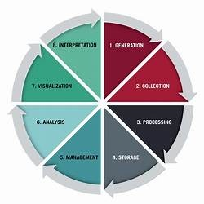
WHAT IS DATA LIFECYCLE?
DATA LIFECYCLE REFERS TO THE DIFFERENT STAGES A UNIT OF DATA UNDERGOES, FROM INITIAL COLLECTION TO WHEN IT’S NO LONGER CONSIDERED USEFUL AND DELETED. (6 Data Lifecycle Stages: Data Cycle Management Guide, n.d.)
PHASES OF LIFECYCLE-
GENERATION
COLLECTION
PROCESSING
STORAGE
MANAGEMENT
ANALYSIS
VISUALIZATION
INTERPRETATION

Slide 3
DATA GENERATION DATA COLLECTION
For, the data lifecycle to start, data must be generated.
For our project, we've acquired information concerning budget recommendations across various positions and anticipated salaries within different departments. The dataset, comprising 8148 entries, was sourced from a website that specializes in this domain, the data.gov website.
As the name suggests, collection of data takes place here.
Not all generated data need to be gathered; only the necessary data should be collected.
In our project, we are analyzing the budgeted amount among different government departments and calculating the average pay rate of them based on their grades.

Slide 4
DATA PROCESSING
Data processing broadly deals with cleaning the data and transforming it from raw inaccessible state to easily accessible format by a process called data wrangling. (The Data Life Cycle - the Data Science Institute at Columbia University, 2020b)
It enhances the accuracy, by improving the quality of data, increasing the privacy and enhancing overall data integrity.
OPENREFINE serves as our tool of choice for cleaning the dataset.

Slide 5
OPENREFINE STEPS-
Upon uploading the CSV file into the Open Refine, we have adhered to fundamental data processing principles, encompassing several key steps:
Substituting null values within the 'SUBSECTION' column with the string "No Subsection".
Converting textual numeric values into numerical format for consistency and analysis.
Leveraging OpenRefine's unique clustering functionality to eradicate lemmatized text across columns.
Employing cell value splitting in certain columns to enhance comprehension and facilitate analysis.

Slide 6
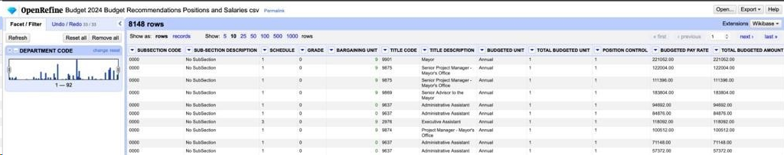
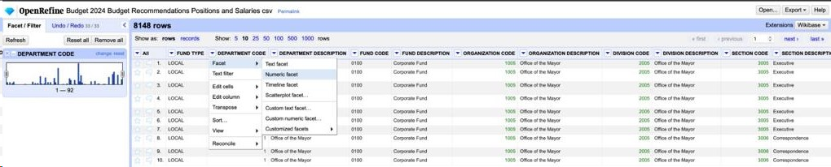
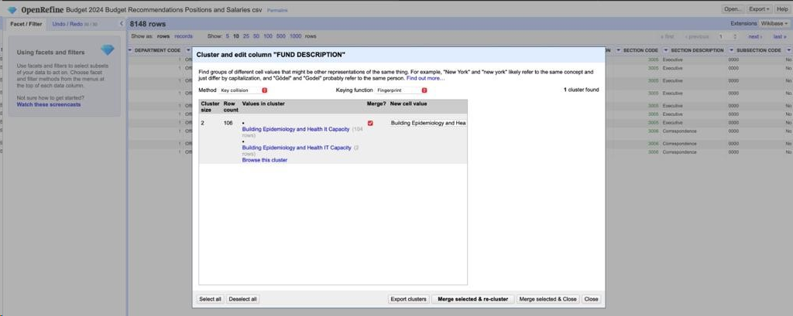

Slide 7
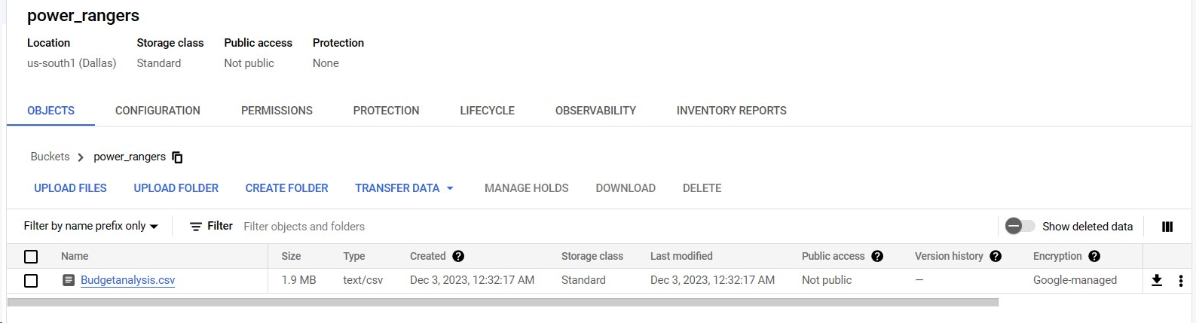
DATA STORAGE
After the data is processed, it is to be stored for future usage. The commonly used methods are creation of datasets or databases.
To house the cleansed dataset, we have opted for Google Cloud Platform's (GCP) storage solution—specifically, leveraging GCP's storage buckets.
The processed CSV file has been securely uploaded onto a GCP bucket.

Slide 8
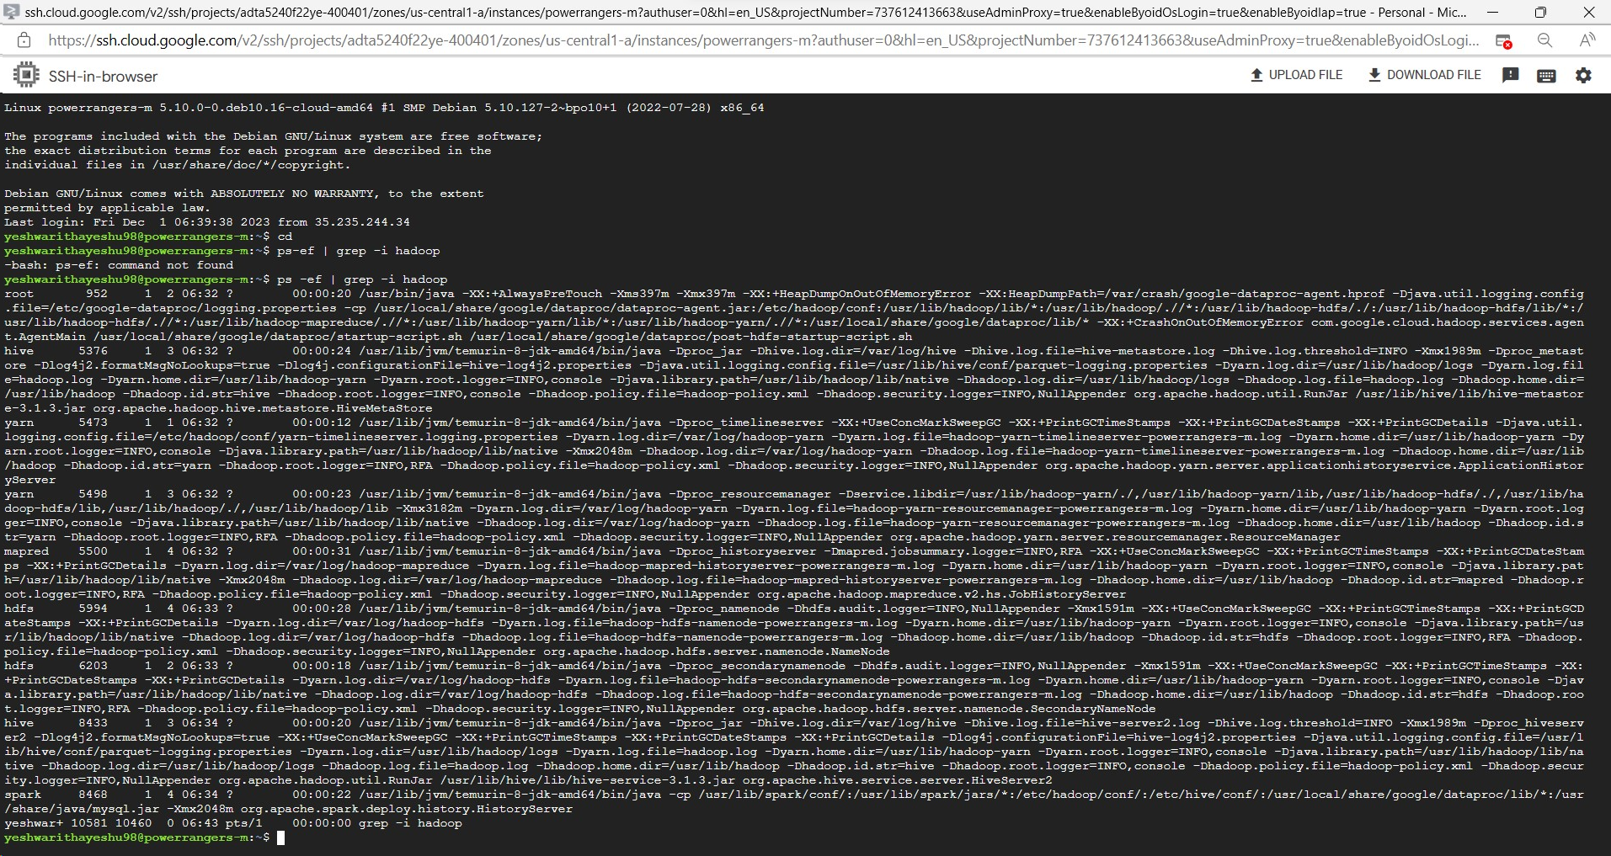
APACHE HADOOP
Apache Hadoop software is an open-source framework that deals with distributed storage and processing of large sets of data.
It is a primary tool that processes data quickly and flexible in nature.
We monitored the Hadoop cluster and entered command to understand the process status(ps).

Slide 9
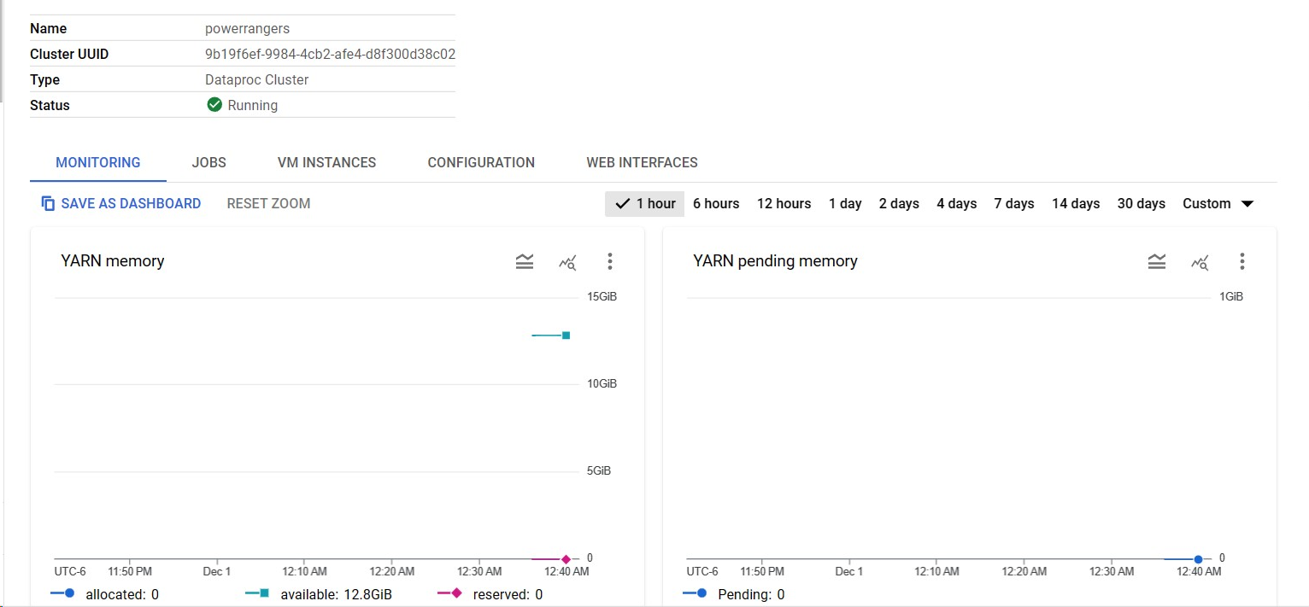
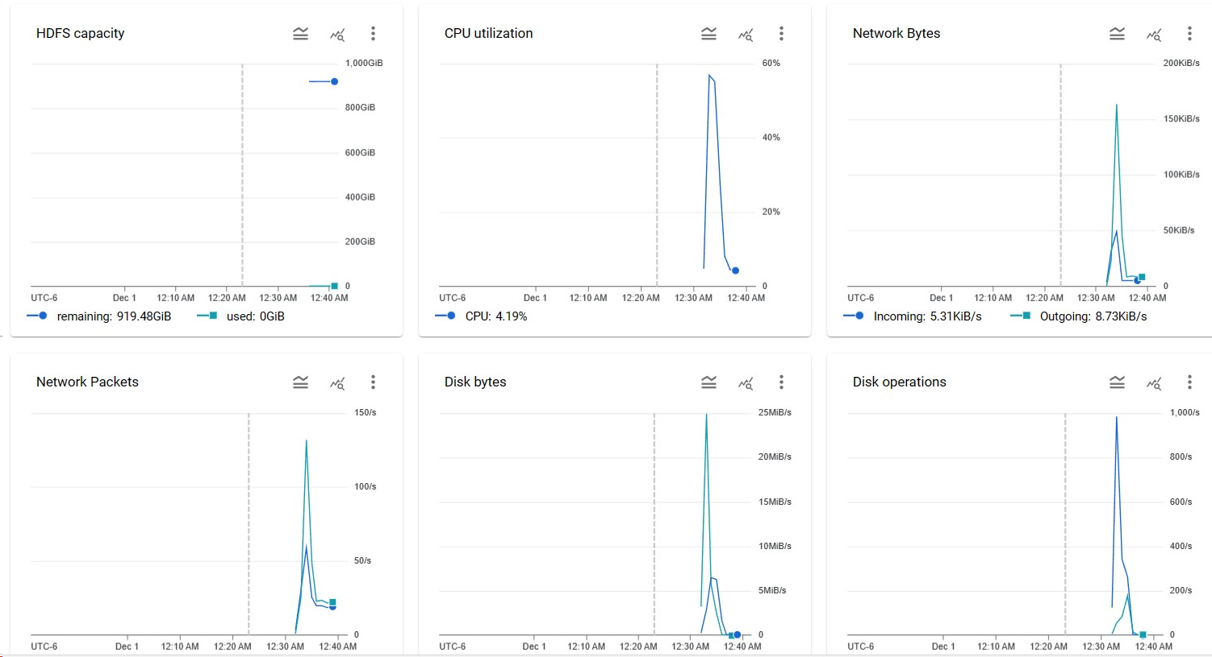
MONITORING HADOOP

Slide 10
DATA MANAGEMENT AND ANALYSIS
Data management involves organizing, storing, and retrieving the data.
Data analysis refers to the processes of analyzing the dataset to retrieve gainful insights.
We used Apache Hive and Apache Spark for carrying out the management phase of data lifecycle.
Big query is used for analyzing the data based on our use case.
Hive and Spark is used to process data using SQL. It is also used for storing data and the execution rate is much faster in Spark. HiveQL helps in creation of tables, loading data and querying the tables according to the requirement.

Slide 11
APACHE HIVE AND SPARK
We used Hive and Spark for our project to manage the data quicker and easier.
We created a new directory in HDFS, to move the files from storage bucket to Manager Node and then into HDFS directory. Then, we copied the contents of the bucket(GCP) to the Manager Node and then moved them to HDFS ecosystem.
We enter hive by entering the beeline command. Here, we created an external table ‘powerrangers_123’ in the location. Then, we executed the command with limit 1 and 5 from the table ‘powerrangers_123’.
We enter spark by entering ‘spark-sql’ and run the commands with limit 1 and 5 from the table ‘powerrangers_123’.

Slide 12
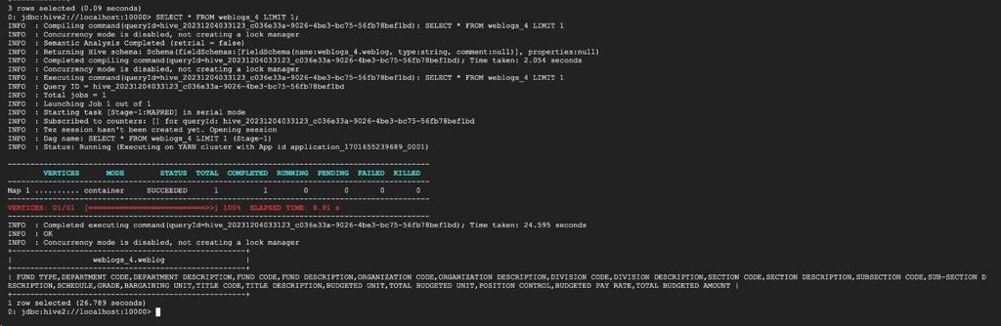
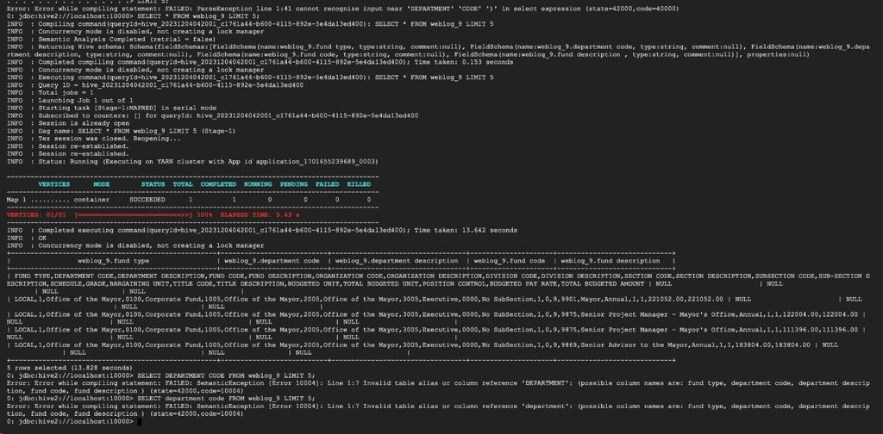
ApACHE HIVE

Slide 13
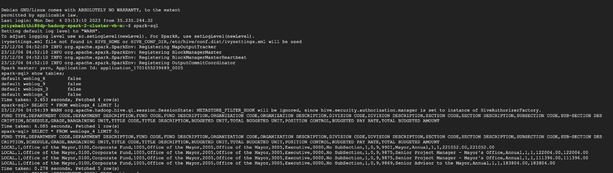
apache SPARK sql

Slide 14
COMPARISION OF HIVE AND SPARK SQL
APACHE HIVE
APACHE SPARK
The time taken to execute the Query 1 with limit 1 is 26.789 seconds.
The time taken to execute the Query 2 with limit 5 is 13.828 seconds.
The time taken to execute the Query 1 with limit 1 is 6.085 seconds.
The time taken to execute the Query 2 with limit 5 is 0.278 seconds.

Slide 15
BIGQUERY
BigQuery stores, analyzes, and visualizes data.
Firstly, we loaded the csv file into BigQuery. Then, we created an external table to compare the required columns namely-Department description, total budgeted amount, average pay rate and grade. This helps in analyzing the data easier.
Then we carried out basic SQL commands to run the queries and gain necessary output.

Slide 16
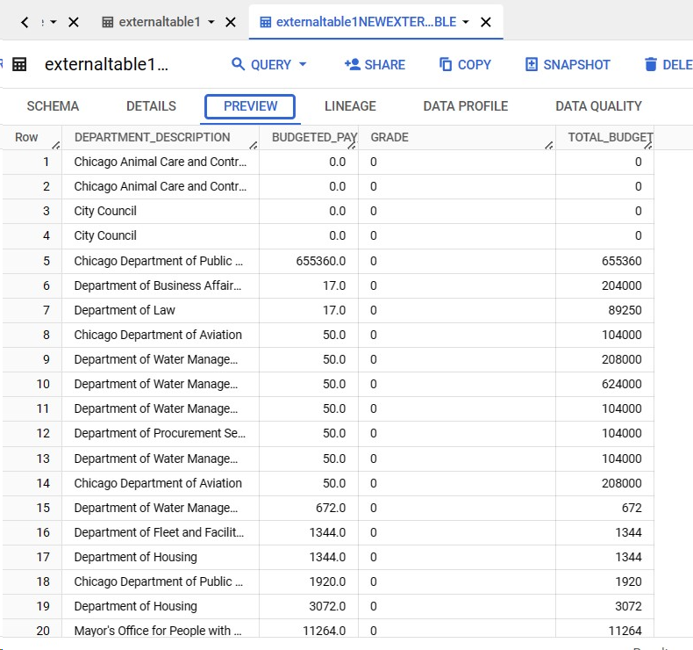
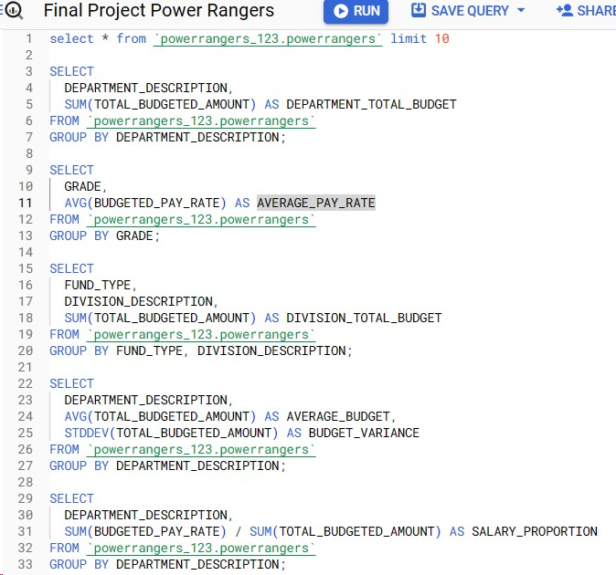

Slide 17
DATA VISUALIZATION
The process of creating graphical representations with the help of visualization tools for easy understanding and usage.
We made use of Tableau for our project in order visually explain the budget analysis of various departments and compare the average budgeted pay rate by the grade of the department.
We analyzed that the Chicago Police Department received the maximum budget from the government followed by Chicago Fire Department. The least budgeted amount is seen with relation to Board of Ethics, Chicago Commission of Human Resources, Department of Environment and Community Commission of Public Safety.
The other graph analyzes the average pay rate is seen in most relevance with the Grade 41 and least with respect to Grade 10. These graphs help us to understand the current year budget analysis and assess the necessary steps to be done by the government to make relevant changes in the budget distribution.

Slide 18
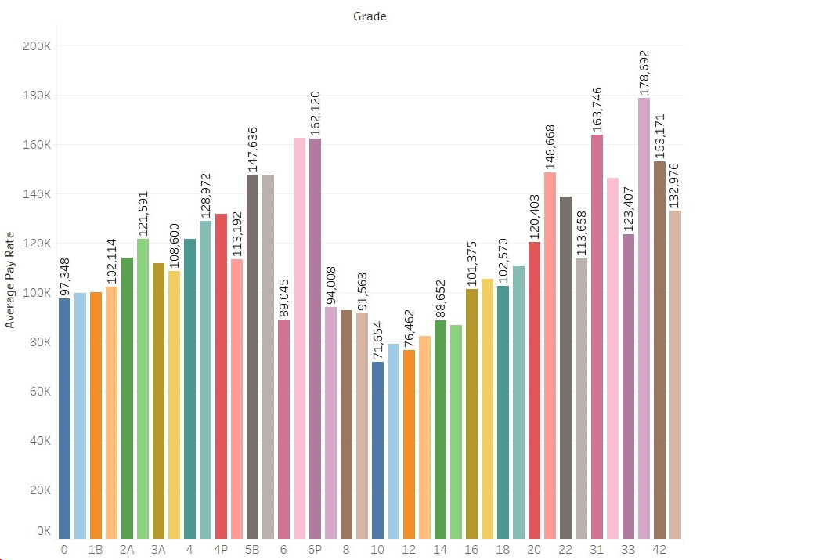
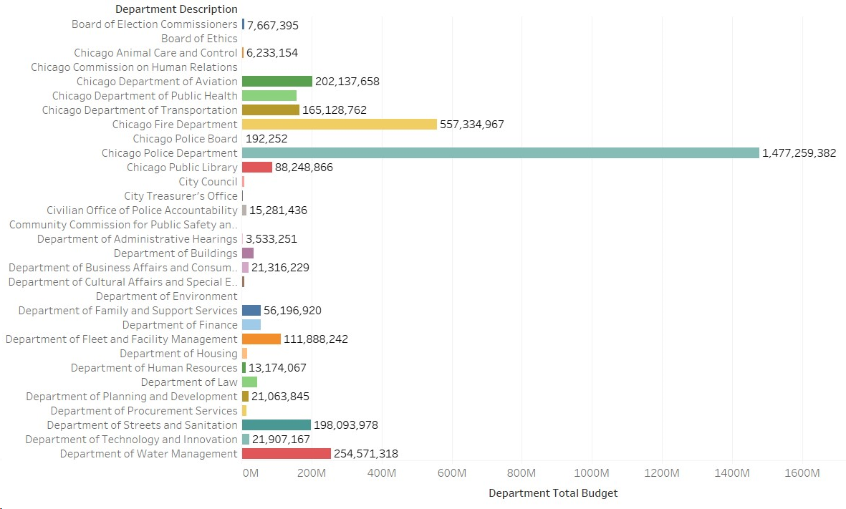

Slide 19
DATA INTERPRETATION
The graph comparing the total budgeted amount and department description depicts the total budgets of multiple departments, showcasing a significant disparity where the Chicago Police Department's budget overshadows all other departments. The magnitude of this difference is so substantial that it obscures the visibility of the remaining bars.
The graph comparing the average pay rate and grade illustrates a balanced distribution of average pay across different grades. There isn't a grade that stands out as being excessively compensated compared to the others like an outlier. Grade 41 shows the highest average pay, while Grade 10 has the lowest.

Slide 20
REFERNCES
8 steps in the data life Cycle | HBS Online. (2021, February 2). Business Insights Blog. https://online.hbs.edu/blog/post/data-life-cycle
The Data Life Cycle - the Data Science Institute at Columbia University. (2020, September 20). The Data Science Institute at Columbia University. https://datascience.columbia.edu/news/2018/the-data-life-cycle/
What is Hadoop and What is it Used For? | Google Cloud. (n.d.). Google Cloud. https://cloud.google.com/learn/what-is-hadoop
Budget - 2024 Budget Recommendations - Positions and Salaries - catalog. (2023, October 13). https://catalog.data.gov/dataset/budget-2024-budget-recommendations-positions-and-salaries

